Slide 1
SECAB INSTITUTE OF ENGINEERING AND TECHNOLOGY, Vijayapur
Workshop on
“Advances in Soil Dynamics and Earthquake Engineering”
Topic
“Seismic Retrofitting of Buildings”
Dr. Santosh Patil
K J College of Engg. Mgt & Research, Pune

Slide 2
What is seismic retrofitting
Objectives
Public safety
Structural survivability
Structural functionality
Structure unaffected
Need for seismic retrofitting of buildings
Common seismic retrofitting techniques
Base Isolators
Supplementary dampers
Tuned mass dampers
Slosh tank
Active control system

Slide 3
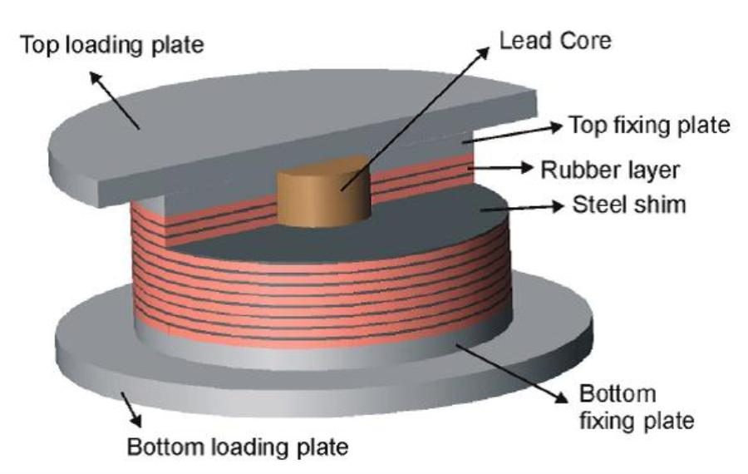
Structures with modern isolation base

Slide 4
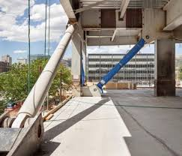

Slide 5
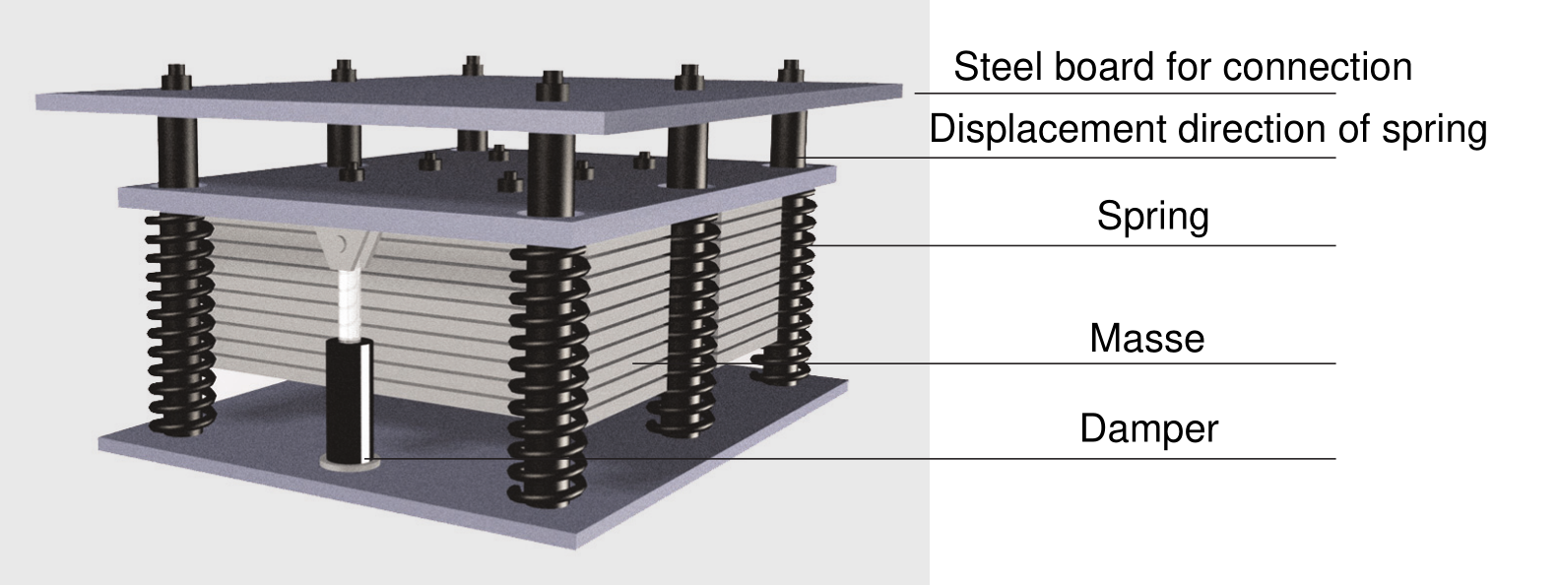

Slide 6
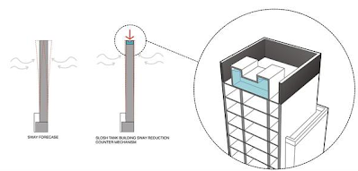

Slide 7
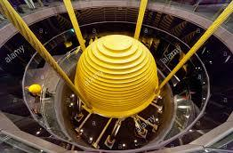

Slide 8
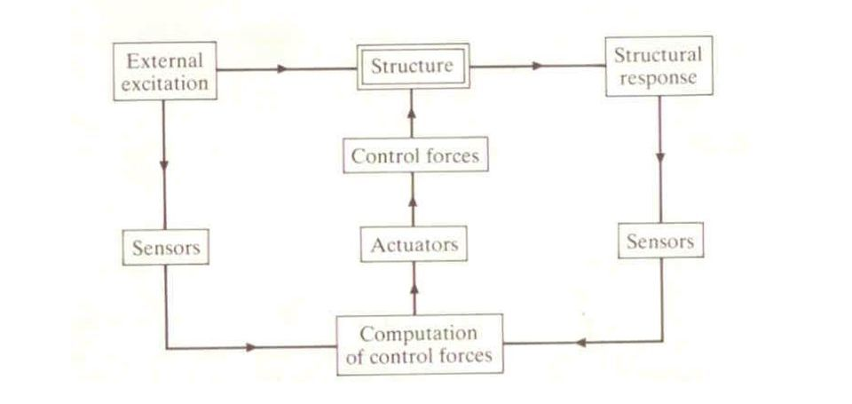

Slide 9
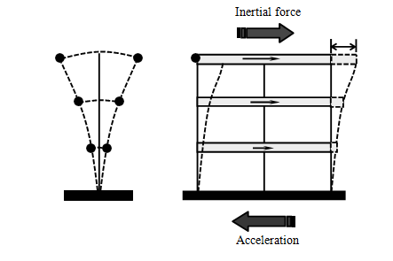
  HOW BUILDINGS RESPOND TO EARTHQUAKES

Slide 10
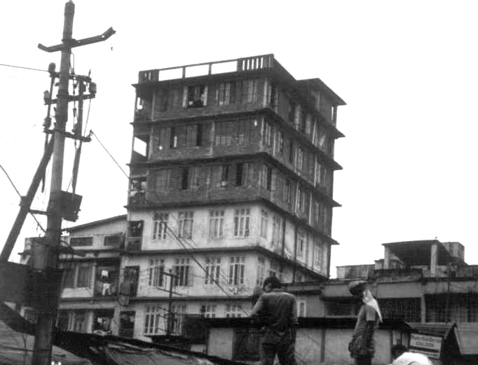

Slide 11
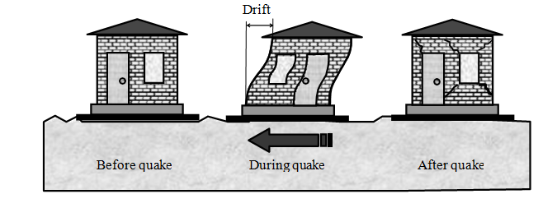
    Effect of Stiffness
Should our buildings be relatively stiff or flexible?

Slide 12
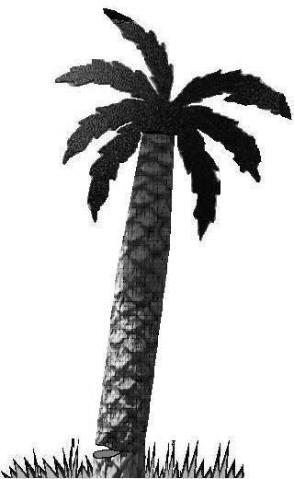
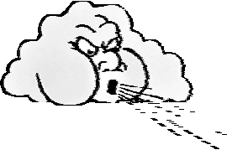
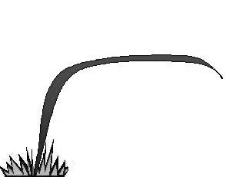
    2. Effect of Ductility

Slide 13
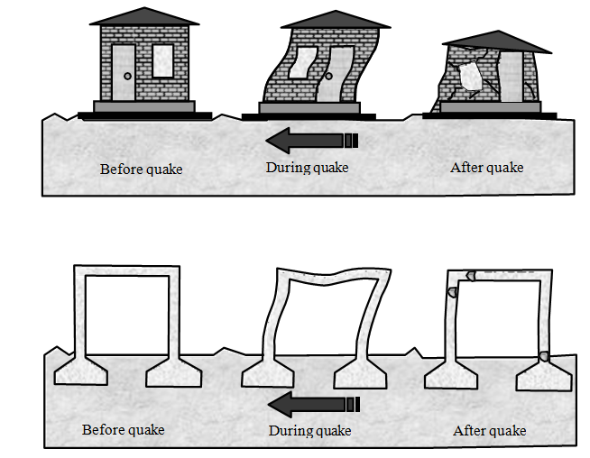

Slide 14
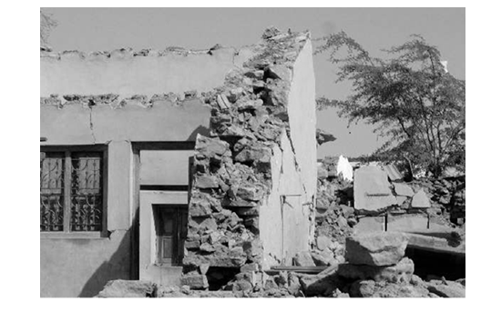

Slide 15
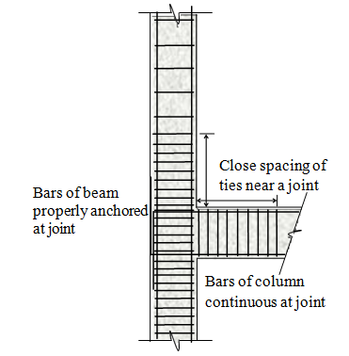

Slide 16
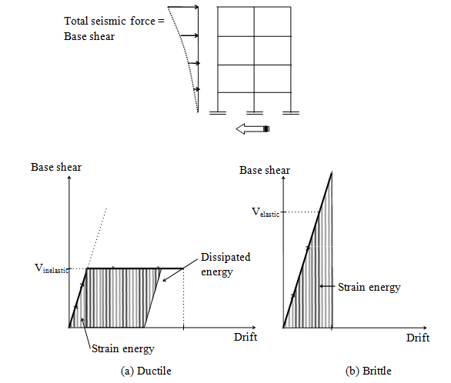

Slide 17
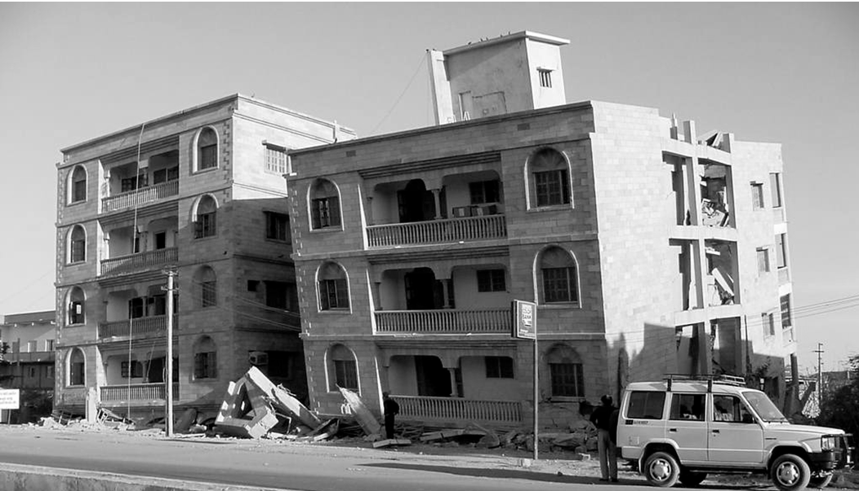
    3. Effect of Strength and Integrity

Slide 18
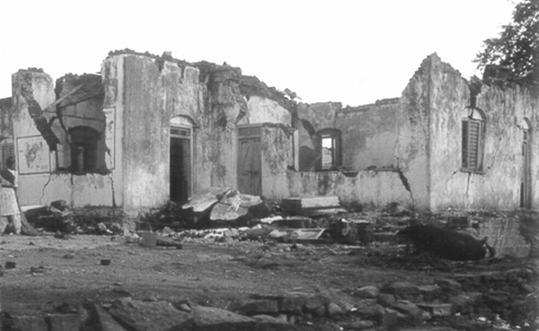

Slide 19
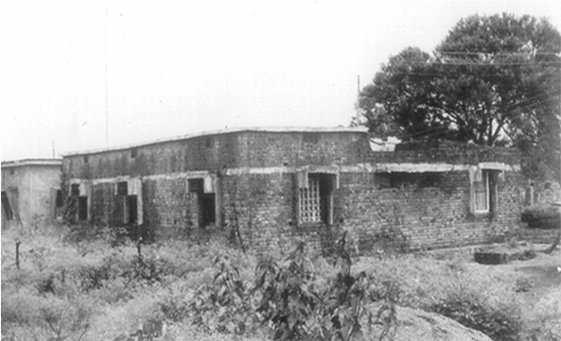

Slide 20
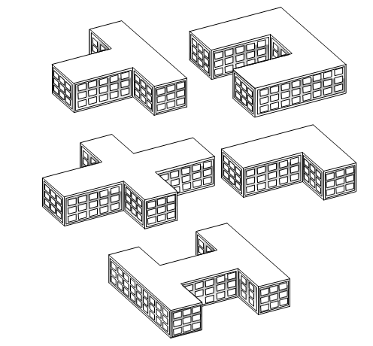
    4. Effect of Layout and Configuration

Slide 21
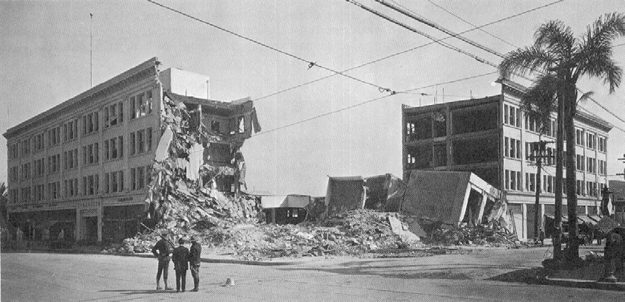

Slide 22
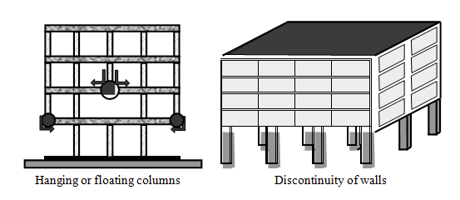

Slide 23
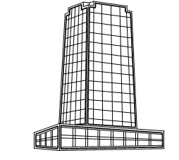
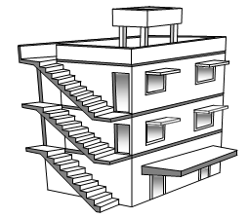

Slide 24
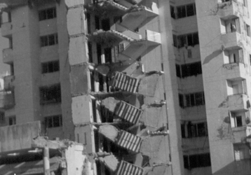

Slide 25
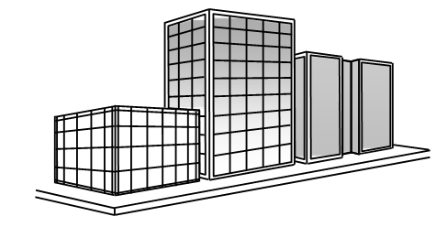

Slide 26
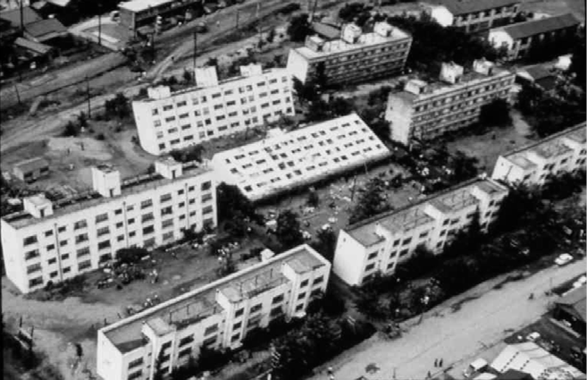
    5. Effect of Soil

Slide 27
Introduction to Seismic Analysis and Design
  EARTHQUAKE RESISTANT DESIGN AND CONSTRUCTION

Slide 28
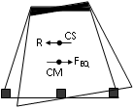
Some of the common irregularities and their effects along with possible retrofitting strategies are described below.
1. Asymmetric plan/Asymmetric structural action
Building plan with one or no axis of symmetry or building with asymmetric structural action
  Earthquake induced inertia force acts at centre of mass, CM.
  Building resistance acts at the centre of stiffness, CS.
  Resulting couple twist the building.
Affect all types of buildings such as masonry, reinforced concrete with or without shear walls and steel buildings.
Retrofitting strategy: reduce asymmetry to bring CM near CS.

Slide 29
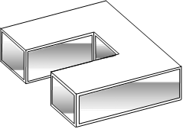
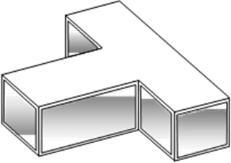
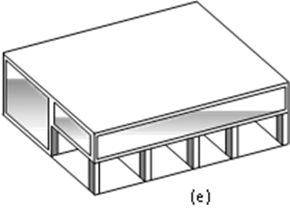
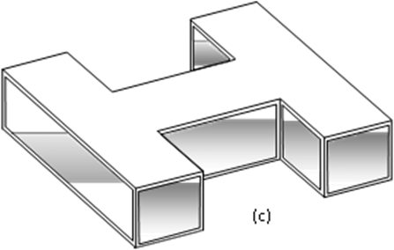

Slide 30
2. Reentrant corners
Building plans with re-entrant corners
  Re-entrant corners tend to open and close during vibration.
  Opening leads to cracking and closing leads to crushing at reentrant corners.
Retrofitting strategy: Cut plan into separate wings

Slide 31
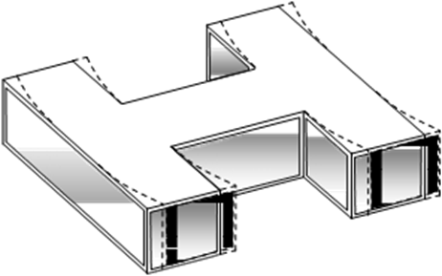
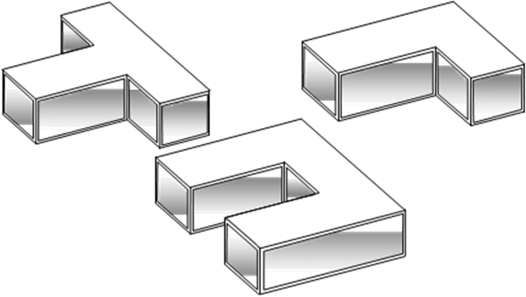

Slide 32
3. Open to sky, Ducts /atriums
Building with large open to sky ducts and/or staircases placed between floor areas (Figure
2.5).
  Cutting of floor diaphragms for light, ventilation, staircases and lifts disturbs force transfer between floor areas.
  Affect multi-storeyed building with reinforced concrete slabs over floor areas.
  Retrofitting strategy: Install horizontal steel bracings in ducts and separate the staircase.

Slide 34
4. Staggered column buildings
Buildings with columns not in line and/or oriented in different directions. Buildings with 230mm columns (Figure 2.6)
  Inadequate frame action to resist seismic loads in either direction.
  230mm columns are too weak and flexible for buildings over 2-storeys.
  Affect reinforced concrete framed buildings
Retrofitting strategy: Provide reinforced concrete shear walls over entire height.

Slide 36
5. Stilt floor buildings
Buildings with full or partial area of ground floor having stilts to facilitate parking or other activity, like shops with rolling shutters (Figure 2.7).
    Absence of walls reduces stiffness of ground storey making it “soft”
    The soft storey gets damaged during earthquake and the building tends to sit due to crushing of columns.
    Affect reinforced concrete buildings with strong masonry walls in upper floors. Retrofitting strategy: Stiffen the ground storey by RC shear walls or steel bracings.

Slide 37





























Slide 38
6. Plaza type buildings
Buildings with large built-up areas in lower storeys and a tower rising above as in hotels shopping mall cum office buildings (Figure 2.8).
  Sudden reduction in stiffness causes damage at the base of tower.
  Affect all types of buildings including modern reinforced concrete buildings and older/historic masonry buildings.
Retrofitting strategies: Provide steel bracing and/or reduce tower height.

Slide 39
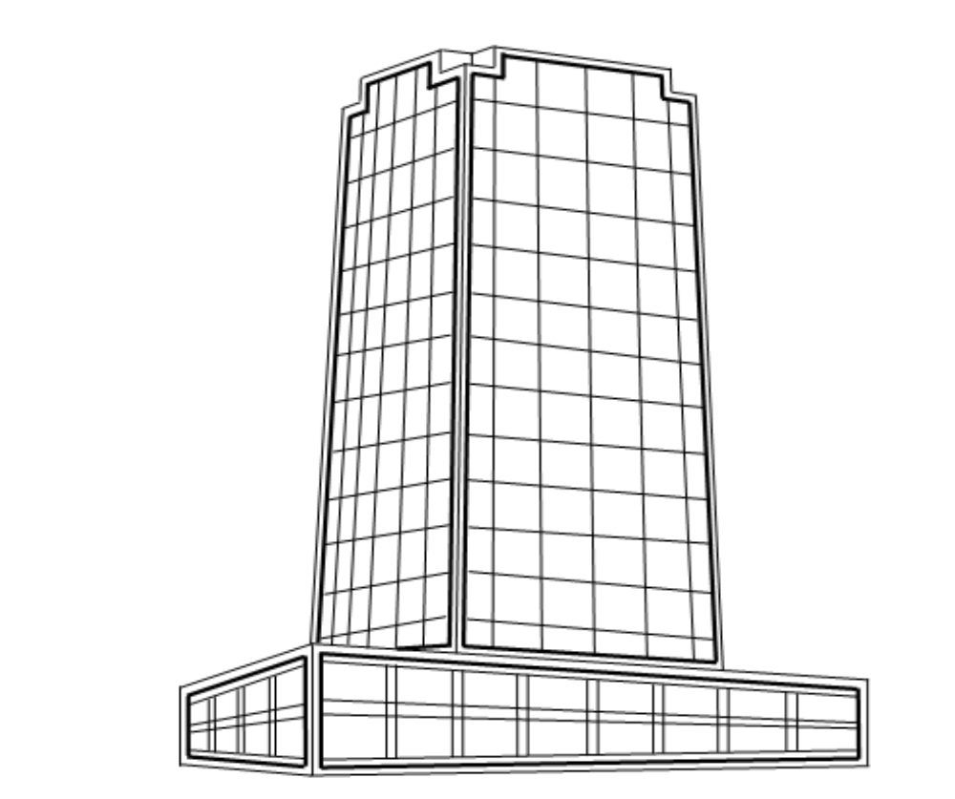

Slide 40
7. Clustered buildings
Buildings close to one another as in city business areas and sometimes having common walls (Figure 2.9).
    Building hit or pound each other during earthquakes due to insufficient space for vibration.
    Affect all types of buildings.
Retrofitting strategy: Increasing gap by demolishing or provide bridge bearings in between.

Slide 41
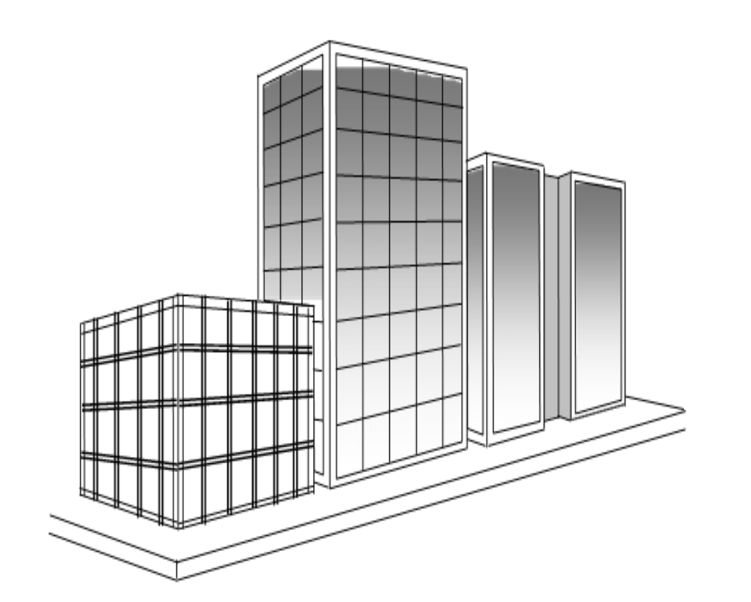

Slide 42
8. Non-ductile buildings
Reinforced buildings not detailed as per IS: 13920 (Figure 2.10) and masonry buildings without reinforcement bands.
  Buildings disintegrate due to inadequate integral action.
  Affect reinforced concrete and masonry buildings.
Retrofitting strategy: Provide extra frames and tie all elements together.

Slide 43
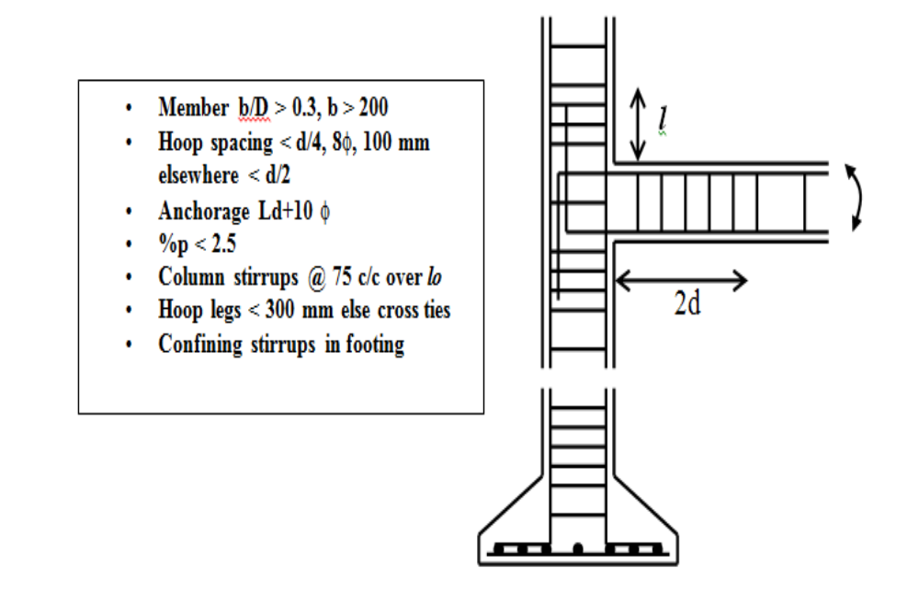

Slide 44
9. Buildings with projecting elements
Buildings with large projections like canopies, balconies, sunshades, parapets, and water tanks in the roofs (Figure 2.11).
    Horizontal projecting elements generally develop stability problems and tend to overturn.
    Vertically projecting elements experience amplified excitations and so develop stability problems.
    Affect all types of buildings except light weight sheetings.
Retrofitting strategy: Reduce projections or reduce their weight. Alternatively they may be braced or anchored to main elements.

Slide 45
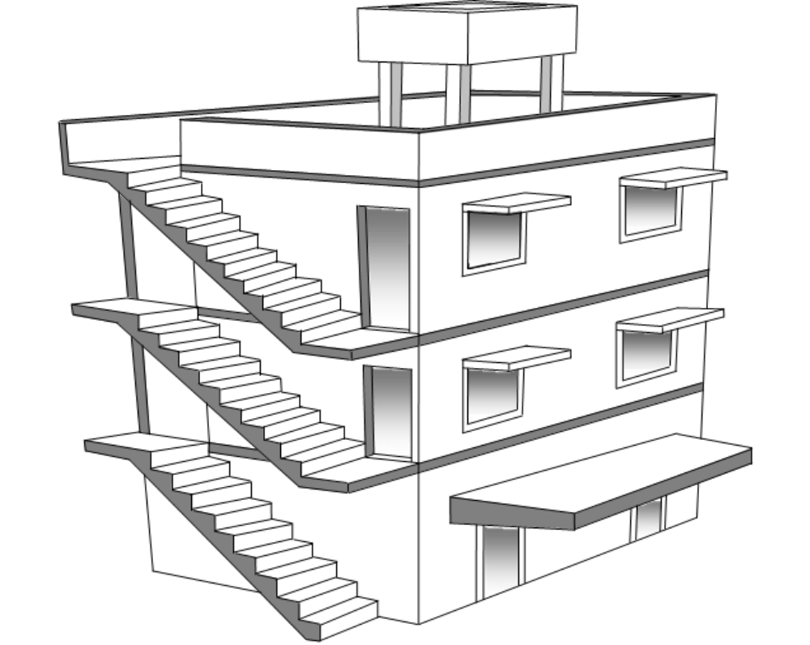

Slide 46
    Seismic Design Philosophy
    Severe earthquakes have an extremely low probability of occurrence during the life of a structure. If a structure has to resist such earthquakes elastically, it would require an expensive lateral load resisting system, which is unwarranted. On the other hand, if the structure loses its aesthetics or functionality quite often due to minor tremors and needs repairs, it will be a very unfavorable design. The usual strategy is:
    In addition to strength requirements at the ultimate load, structures are also designed to have adequate stiffness in the lateral direction under service loads. This is usually ensured, by limiting the relative displacement between successive floors, known as the storey drift. For buildings, a maximum allowable storey drift of 0.004 times the storey height is normally used under moderate earthquakes.

Slide 47
    Analysis and Design for Earthquake Loads
Structures are usually designed for gravity loads and checked for earthquake loading. In conformity with the design philosophy, this check consists of two steps - the first ensures elastic response under moderate earthquakes and the second ensures that collapse is precluded under a severe earthquake. Due to the uncertainties associated in predicting the inelastic response, the second check may be dispensed with, by providing adequate ductility and energy dissipation capacity.
The important factors, which influence earthquake resistant design are, the geographical location of the structure, the site soil and foundation condition, the importance of the structure, the dynamic characteristics of the structure such as the natural periods and the properties of the structure such as strength, stiffness, ductility, and energy dissipation capacity. These factors are considered directly or indirectly in all the methods of analysis.
The response spectrum method has the advantage that, it can account for irregularities as well as higher mode contributions and gives more accurate results. Therefore, this is the most widely used method in seismic analysis. The method proposed by the Indian code.

Slide 48
    General Design Requirements
The IS 1893 code gives guidelines to classify buildings as regular or irregular based on simple calculations. If a building is regular, a simplified method of analysis can be adopted. The types of irregularities defined in the code are

Slide 49
Plan Irregularities
1. Torsion Irregularity: To be considered when floor diaphragms are rigid in their own plan in relation to the vertical structural elements that resist the lateral forces. Torsional irregularity to be considered to exist when the maximum storey drift, computed with design eccentricity, at one end of the structures transverse to an axis is more than 1.2 times the average of the storey drifts at the two ends of the structure.
2. Re-entrant Corners: Plan configurations of a structure and its lateral force resisting system contain re-entrant corners, where both projections of the structure beyond the re- entrant corner are greater than 15 percent of its plan dimension in the given direction.
3. Diaphragm Discontinuity: Diaphragms with abrupt discontinuities or variations in stiffness, including those having cut-out or open areas greater than 50 percent of the gross enclosed diaphragm area, or changes in effective diaphragm stiffness of more than 50 percent from one storey to the next.
4. Out-of-plane offsets: Discontinuities in a lateral force resistance path, such as out-of- plane offsets of vertical elements.
5. Non-parallel systems: The vertical elements resisting the lateral force are not parallel to or symmetric about the major orthogonal axes or the lateral force resisting element.

Slide 50
Vertical Irregularities
1. a) Stiffness Irregularity – Soft Storey: A soft storey is one in which the lateral stiffness is less than 70 percent of that in the storey above or less than 80 percent of the average lateral stiffness of the three storeys above
b) Stiffness Irregularity – Extreme Soft Storey: A extreme soft storey is one in which the lateral stiffness is less than 60 percent of that in the storey above or less than 70 percent of the average stiffness of the three storeys above. For example, buildings on STILTS will fall under this category.
2. Mass Irregularity: Mass irregularity shall be considered to exist where the seismic weight of any storey is more than 200 percent of that of its adjacent storeys. The irregularity need not be considered in case of roofs.

Slide 51
3. Vertical Geometric Irregularity:
Vertical geometric irregularity shall be considered to exist where the horizontal dimension of the lateral force resisting system in any storey is more than 150 percent of that in its adjacent storey.
4. In-Plane Discontinuity in Vertical Elements Resisting Lateral Force:
A in-plane offset of the lateral force resisting elements greater than the length of those elements.
5. Discontinuity in Capacity – Weak Storey:
A weak storey is one in which the storey lateral strength is less than 80 percent of that in the storey above. The storey lateral strength is the total strength of all seismic force resisting elements sharing the storey shear in the considered direction.

Slide 52
    Calculation of Earthquake Loads
The horizontal seismic coefficient A_{h} takes into account the location of the structure by means of a zone factor Z, the importance of the structure by means of a factor I and the ductility by means of a factor R. It also considers the flexibility of the structure-foundation system by means of an acceleration ratio Sa/g , which is a function of the natural time period T. This last ratio is given in the form of a graph known as the response spectrum. The horizontal seismic coefficient A_{h} is given by
An = Z I Sa / 2 R g
where,
Z = Zone factor corresponding to the seismic zone obtained from a map
I = Importance factor
R = Response reduction factor.
Zone factor Z
Seismic zone | II | III | IV | V
Seismic intensity | Low | Moderate | Severe | Very severe
Z | 0.10 | 0.16 | 0.24 | 0.36

Slide 53
For important service and community buildings, such as hospitals, schools; monumental structures; emergency buildings like telephone exchange, television stations, radio stations, railway stations, fire station buildings; large community halls like cinemas, assembly halls and subway stations, power stations, the importance factor may be taken as 1.5 but for most buildings it may be taken as 1.0.
The response reduction factor R is also specified for various buildings depending on the type of detailing adopted. For example, if a building is detailed as per ductile detailing provisions given in IS 13920, then the R factor is 5, else it is 3.
The natural time period T is very important and should be calculated correctly. For single storey structures, it may be taken as T = 2pÖ(k/m) where k is the lateral (horizontal) stiffness of the supporting structure and m is the mass of the roof usually taken as the sum of the roof dead load plus 50% of the live load divided by the acceleration due to gravity.

Slide 54
Fundamental natural period(sec) of MR frame buildings without infills (solid walls),
Ta = 0.075 h^{0.75} for RC buildings
Ta = 0.085 h^{0.75} ^{f}or steel buildings
where, h= height of building in m. And, for frames with infills,
Ta = 0.09h/√d
where
d= base dimension of the building at the plinth level in m

Slide 55
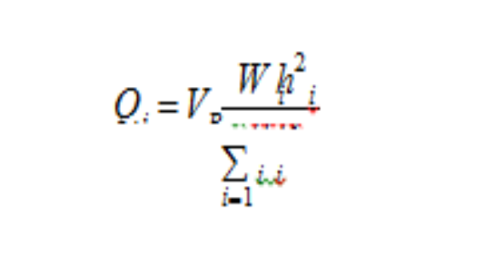
Finally, the acceleration ratio Sa/g can be obtained from the graph corresponding to Ta and the soil type in Figure. In this figure, medium soil corresponds to stiff clay or sand and soft soil corresponds to loose clay and loamy soils.
The base shear is then given by
V_{b}=A_{h} W
The base shear calculated above is then distributed along the height of the building using the formula,
Q_{i} is the lateral force at the top of floor i,
W_{i} is the total of dead and appropriate amount of live load at the top of floor i,
h_{i} is the height measured from the base of the building to the top of floor i,
n is the number of storeys.

Slide 56
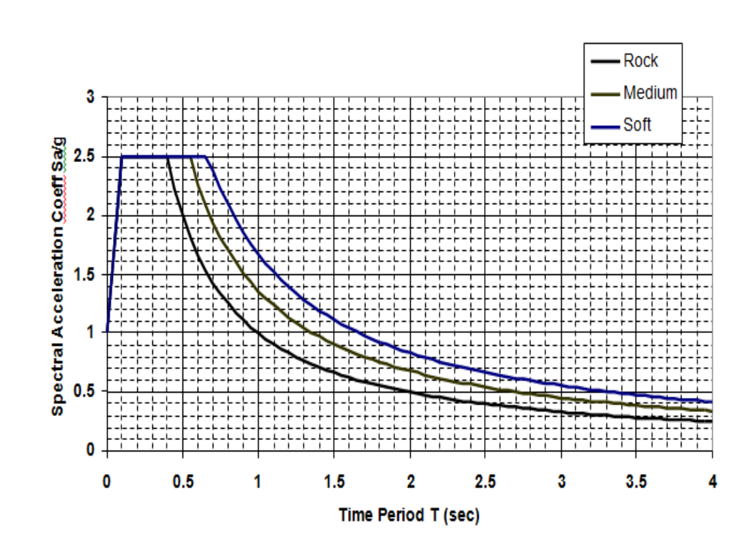

Slide 57
Retrofit of Non-Engineered Buildings
SEISMIC RESISTANT FEATURES
REPAIR MATERIALS:
Epoxy Resins
B) Epoxy Mortar:
C) Quick Setting Cement Mortars:
D) Shotcrete:

Slide 58
E)Micro-concrete:
F) Fibre-reinforced Concrete:
G) Fibre-reinforced Polymers:
H) Ferro-cement:

Slide 59
REPAIR TECHNIQUES
The applicability of repair techniques varies depending on the problems to be addressed. The associated techniques are to be presented under specific problems.
Small Cracks:

Slide 60
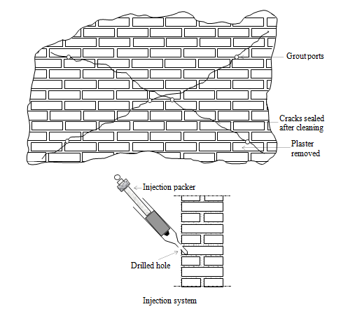

Slide 61
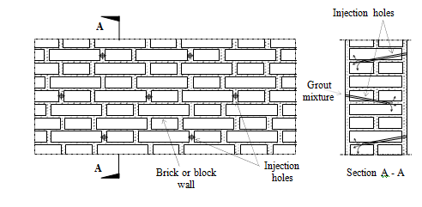

Slide 62
Large Cracks and Crushed Material:
Damaged Reinforcement:

Slide 63
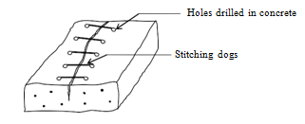

Slide 64
STRENGTHENING OF ROOFS
The roof should effectively distribute the lateral load generated due to earthquake, to the walls. In other words, the roof should act as a horizontal diaphragm. There are varieties of roofs in non-engineered buildings. The most common types of roofs are considered.
Timber Truss Roofs
A timber roof truss usually supports tiles which are brittle and tend to get dislodged. The tiles can be replaced with galvanised iron corrugated sheets. A false ceiling of brittle material is hazardous. Ductile material like bamboo matting or light foam type material can be used to replace brittle false ceiling. Anchors of roof trusses to supporting walls should be improved and the roof truss thrust on the walls should be minimized or eliminated. This can be achieved by providing new bracing as shown

Slide 65
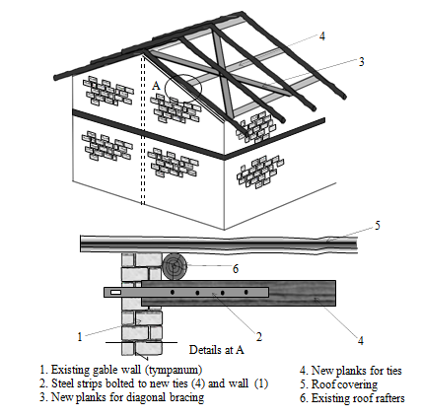

Slide 66
Terrace Roofs
Where the roof consists of prefabricated units or channels, integration of individual units is a must. The units can be integrated by a cast-in-situ reinforced concrete topping and a band. The technique is similar to that shown in fig. The detail can also be adopted for Madras terrace roof.

Slide 67
Roofs of Light Weight Sheets
Although roofs made of asbestos or galvanised iron/aluminum sheets do not cause heavy damage to the building because of their light weight, there is damage in the roofs during earthquakes. This can be reduced by close spacing of the hold down bolts, which connect the sheets to the purlins.

Slide 68
Thatched Roofs
Thatch made from leaves of palm and coconut trees is widely used as roofing material in rural areas. Thatched roof are blown off during cyclones, damaged during earthquakes and are also vulnerable to fire. The performance of the thatched roof can be significantly improved by holding it down using ropes in a diagonal fashion.

Slide 69
STRENGTHENING OF WALLS
The walls support the roof and upstairs floor, as well as provide resistance to lateral load. The walls can be strengthened by the following methods.
Grouting
Containment reinforcement
Use of Ferro-cement
Use of fibre reinforced polymer
Containment Reinforcement:

Slide 70
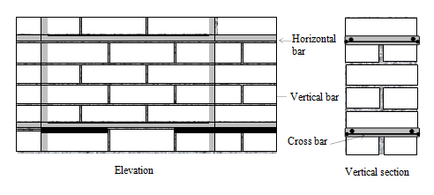

Slide 71
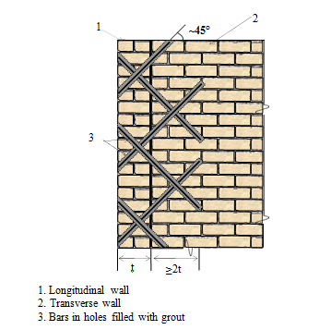

Slide 72
STRENGTHENING OF PILLARS
In a barrack type of building, pillars made of bricks are placed along the corridor. These pillars support the roof trusses. In absence of any reinforcement, the pillars are weak under lateral forces, leading to failures. Such pillars can be strengthened by concrete jacketing as shown. The additional stirrups can be inserted from the top of the pillars after lifting the truss by a temporary support. Else, each stirrup has to be made of two pieces as shown under column jacketing. The trusses should be properly anchored to the pillars.

Slide 74
TECHNIQUES FOR GLOBAL STRENGTHENING
Global strengthening aims to improve the lateral load resistance of the building as a whole. This will relieve overloaded members and ensure better seismic behaviour.
Introduction to Joints:
The buildings having large aspect ratio (length-to-breadth ratio) or projections in plan, behave badly during earthquakes. Such buildings can be separated into blocks with a crumple section in between them. New walls are inserted and tied with the existing walls to avoid long length of walls and to reduce the distance between centre of mass and centre of rigidity for each block.

Slide 76
Introduction of Walls:
Long walls are vulnerable to out-of-plan collapse. For a wall of thickness t and cross wall spacing a, the ratio a/t should not exceed 40. To ensure this cross walls can be added as indicated in figure. The spaces can be utilized appropriately without significantly altering the functionality of the building. This type of intervention is possible in long barrack type buildings used for schools, dormitories or other purpose. The junction between the new wall and the old wall will be a T-junction. The details of tying reinforcement are given in IS 13935: 1993.

Slide 78
Introduction of Pilasters or Buttresses:
In the case of longitudinal walls of the barrack type buildings, pilasters or buttress walls added externally will enhance lateral load resistance. The buttresses need to be integrated with the existing wall by key stones.

Slide 79
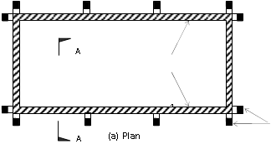
2
2
3
1
1
B
(c) Detail B
4
      Section A - A
1 Existing wall 2 Buttress or pilaster
3 Key stones 4 Foundation

Slide 80
Improvement of the Frame:
Most of the non-engineered constructions do not have adequate lateral load resistance. The rural hut made with casuarinas and bamboo posts is a typical example. Two modes of collapse of the frame is shown in figure. Figure shows how the introduction of braces in the periphery stabilizes the frame. Provision of doors can be accommodated by providing braces on either side as shown in the second sketch of the same figure. There can be cross braces or knee braces in the vertical planes of the walls or in the horizontal plane at the top of the walls, as shown.

Slide 81
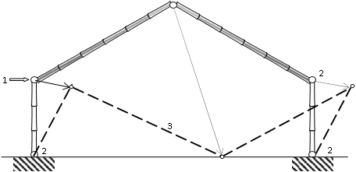
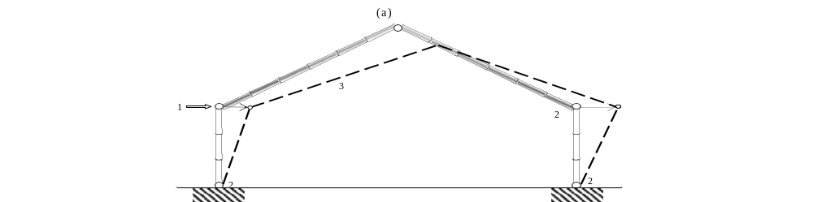
        1. Earthquake force 2. Failure of joints 3. Collapse frame
Collapse modes of a typical hut

Slide 82
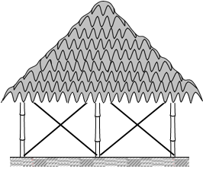



Slide 83






Slide 84
Splint and Bandage Strengthening Technique
To economise in the retrofit cost while targeting to enhance the integrity of the building, Ferro-cement with galvanised welded steel wire mesh can be added on the exterior of the walls in the form of vertical splints adjacent to openings and horizontal bandages over the openings as shown.
The techniques covered in this discussion are intended to provide various options for retrofitting non-engineered buildings. However, given the wide variety of non-engineered buildings, differences in the detailing for each technique are expected to be based on the local condition and availability of materials, skills and funds. Hence, importance should always be placed on the detailing while designing the most appropriate repair and retrofit scheme for a building.

Slide 85


